Slide 1
Welcome & Introduction Talk
Data Science Workshop I
Exec & Division Heads

Slide 2
Focus 22/23
Women in Data Science
Hosting a panel of 6 women at a Manchester venue @12 Oct (Ada Lovelace day)
4 Confirmed Panelists: NHS, IBM, WGSN & Mishcon de Reya LLP, and currently searching corporate individuals.
Expecting audience of 100 Manchester students
Networking & Community Events
Data Science Representation
First-year Representatives
15 Representatives will be the key link between the society & 1st year students to promote interest among 1st Years.
Subject Ambassadors
10 Ambassadors across diverse disciplines. To aid in increasing participants across the university.
Diversity
Inclusion
Project-based Learning
Delivering up to 16 beginner workshops focus on Data Science and Machine Learning
Organize guest talks and advanced workshops on more diverse topics
Data Club
Informal networking sessions, community building and guests.
Promotes collaborative working.
Partnership with *MUTIS
Coordination on Marketing, Socials, Workshops. Also, laying the foundations of a wider Alliance for societies.
Connection with *IDSAI
Links with Academia: guest speakers, further studies and research opportunities.
Accessibility
Collaboration
*MUTIS - Trading & Investment Society
*IDSAI - Institute of Data Science & AI

Slide 3

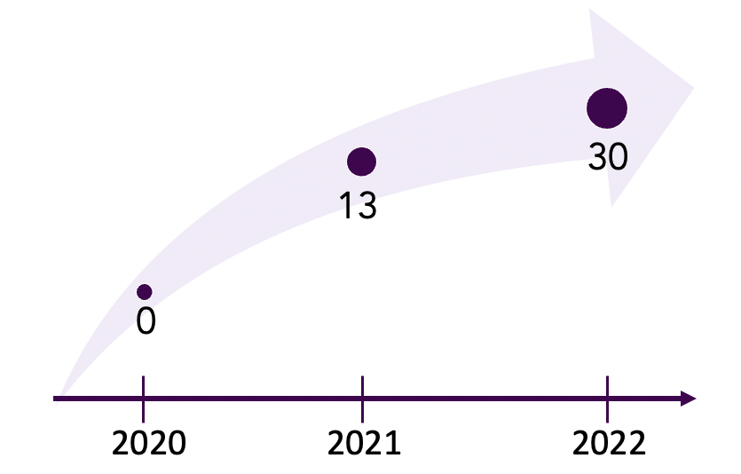
Divisions
Exec
Operations
Sponsorship
Corporate Affairs
Outreach
Workshops
AlgoTrading
Deal with:
venue hiring
logistics
merchandise
socials organization
general support
1. Seek out:
sponsorships
partnerships
mentorships
2. Handle:
finances & funding
1. Establish:
networking
corporate relations
2. Lead:
subject reps
3. Collaborate with:
societies
committee
1. Maintain:
social media
inclusion
2. Lead:
first-year reps
3. Organize:
Women in DS
MUTIS & UCL AI collab
1. Provide:
DS content
project-based learning (PBL)
academic & industry platform
2. Facilitate:
New Data Club
Committee
members
Notes:
Main Responsibilities:
1 workshop a week which focuses on quantitative finance
Collaboration with the Finance society at UoM

Slide 4


Sponsorship
Look out for sponsors & partners
Peak - Manchester-based Decision Intelligence company which uses Data Science to transform businesses.
CGG - Provides services and solutions in Earth science, sensing and monitoring.

Slide 5



Sponsorship
Look out for sponsors & partners
Dicey Tech - Provide a platform where students can gain skills, industry insight and connect with employers through project challenges.
Datern - Provides opportunities to fast growth companies and students who are all about making a difference with data.
Fuzzy Labs - Connects with the client’s data scientists to consult them how to unleash their AI by solving machine learning problems that the firms face.

Slide 6
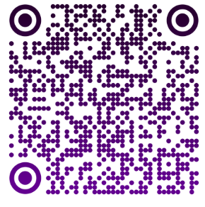
Corporate Relations
Provide networking & connections
Women in Data Science Event
12th October for Ada Lovelace day
5-6 Speakers, includes NHS, IBM, WGSN & Mishcon de Reya LLP
Topic: Insight into industry (diverse careers in DS)
Connect you or refer to individuals to get your dream job or career. Just a message a way.
Subject Ambassadors
You will be one of the faces of our society to promote, volunteer and upskill in a society.
Aiding with obtaining top-notch sponsors and individuals to workshops & events
[Scan the QR Code to become a Subject Rep]

Slide 7
Workshops
Provide workshops & academic activities
What we can offer to you
Deliver essential Data Science / Machine Learning fundamentals via Project-based Workshops
Provide you with higher-level Machine Learning Projects or Hackathons
The workshop executive role: stay tuned!
Department role
Responsible for Weekly Content Delivering:
Plan, Design and Deliver weekly workshops
Cooperate with Dicey Tech to deliver projects recognized by Big-Names
Assist Operation Team to arrange Hackathons & Guest Talks

Slide 8
What is Data Science?

Slide 9
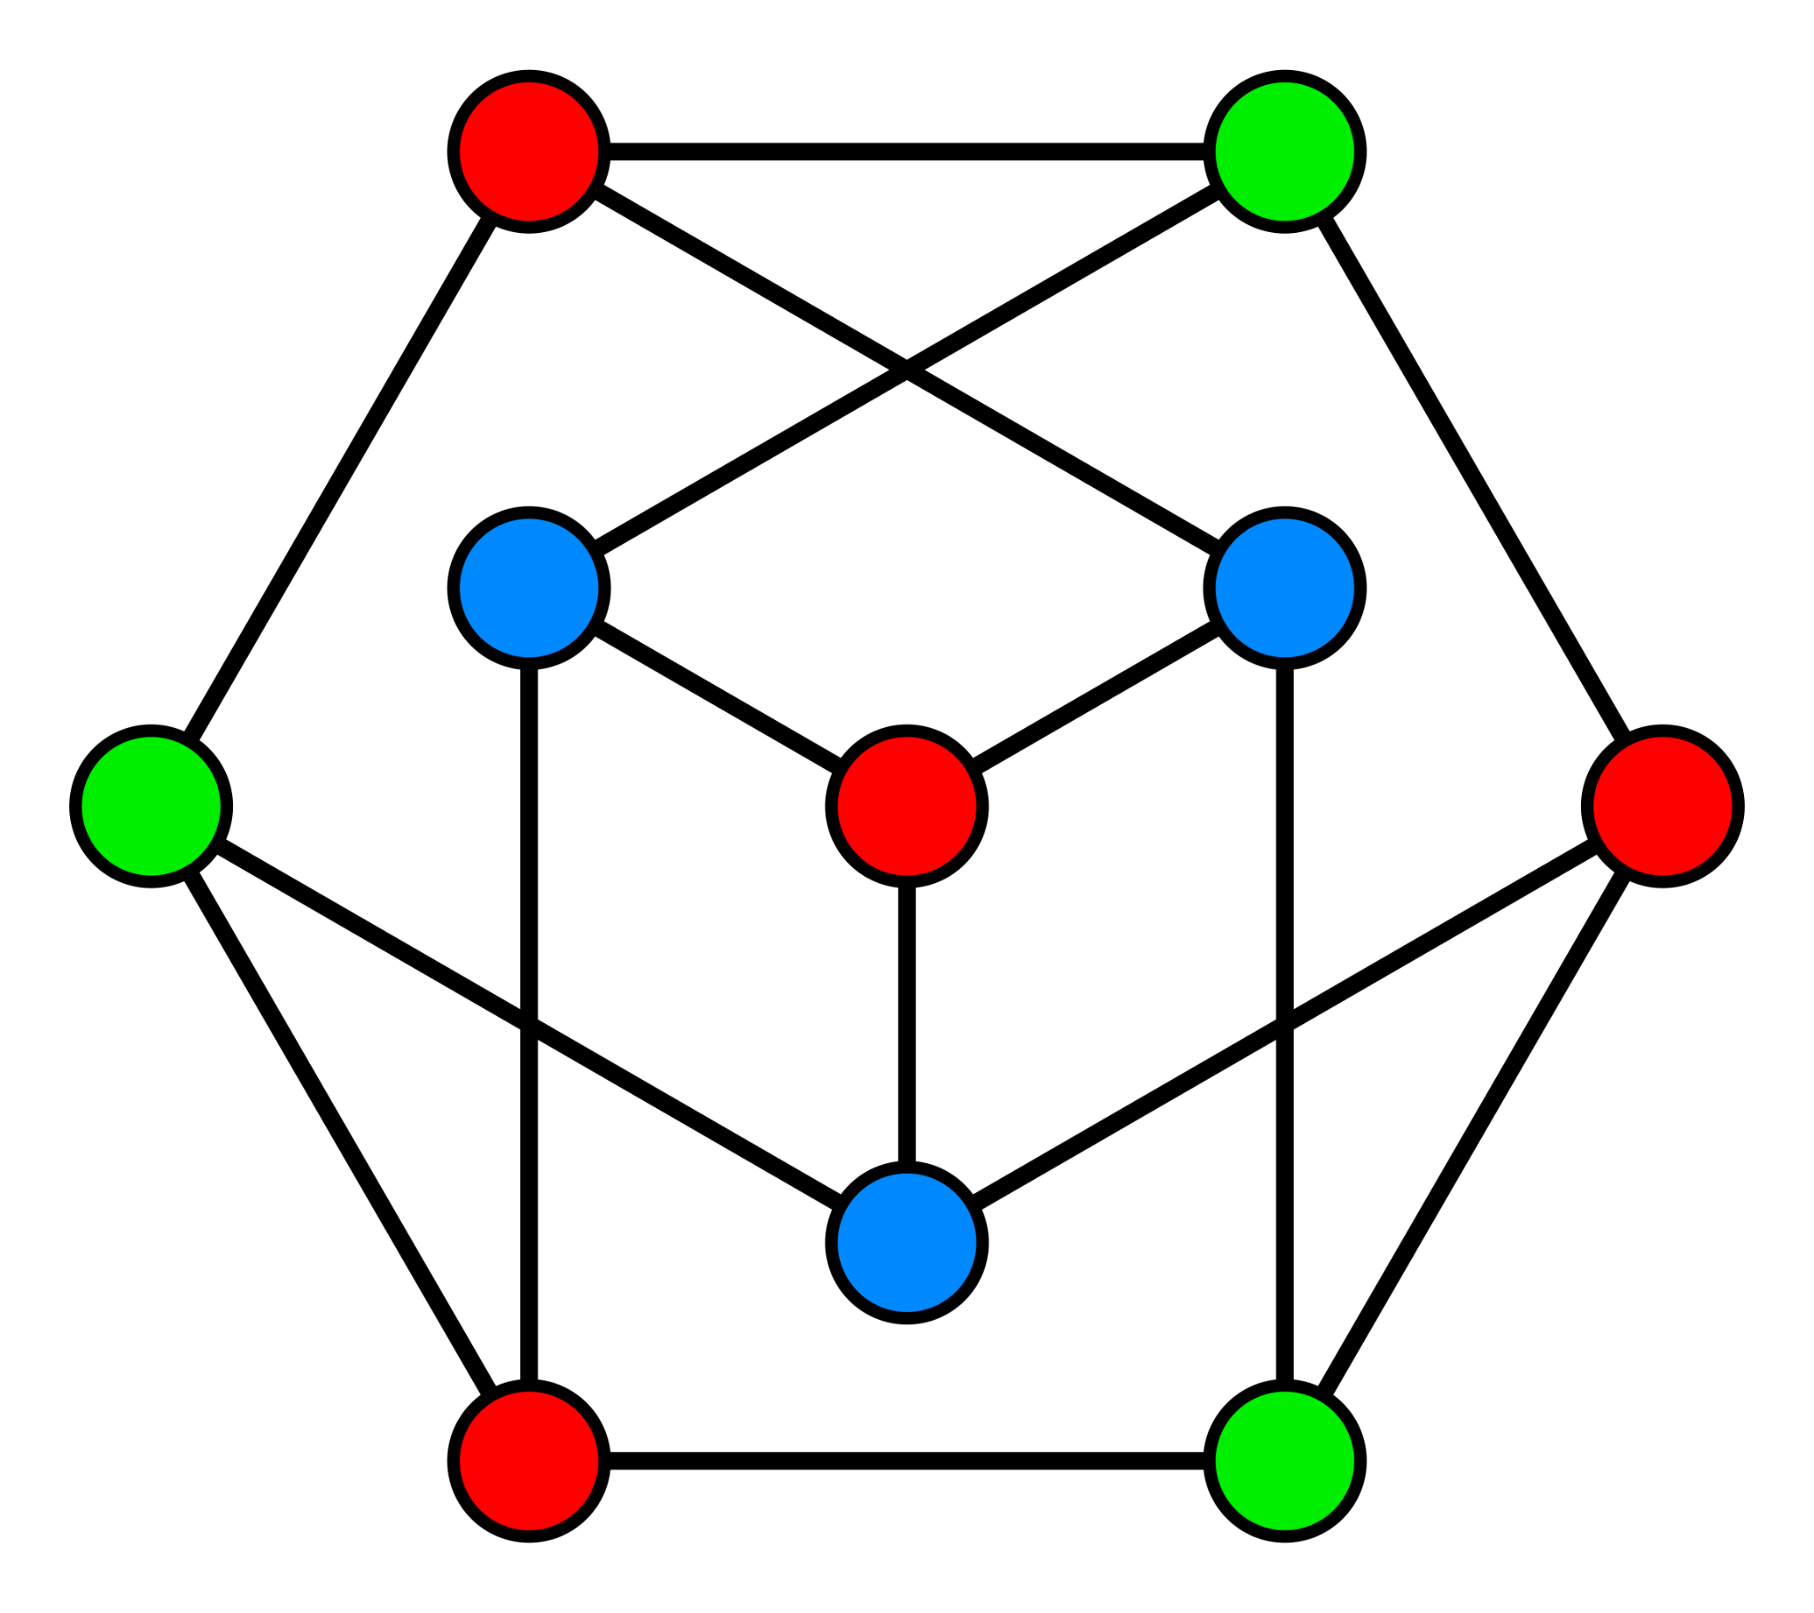
Extract Knowledge from Data
Countless applications:
Fraud Detection
Tumor Recognition
Informing public policy
Interdisciplinary:
Machine Learning
Mathematics and Statistics
Domain Knowledge

Slide 10

Beyond existing data, scientifically
Scientific method:
Hypothesis, Experiment, Validation (Workshops to train all of these!)
Forecasting and Predicting:
Predict new data based on existing data with an interdisciplinary approach
What will be the price of this stock tomorrow?
How effective will this drug be?
How can I make my electoral campaign more effective?

Slide 11
What is Machine Learning?
(Data Driven)

Slide 12
“Machine learning (ML) is a field of inquiry devoted to understanding and building methods that ‘learn’, that is, methods that leverage data to improve performance on some set of tasks."
From Wikipedia
“Machine learning is a branch of artificial intelligence (AI) and computer science which focuses on the use of data and algorithms to imitate the way that humans learn, gradually improving its accuracy.”
From IBM
“Machine learning is a type of artificial intelligence that allows software applications to become more accurate at predicting outcomes without being explicitly programmed to do so. ”
From Some Random Blog

Slide 13
Our Definition:
The approach to solve real-life problems using models & algorithms that learns from data

Slide 14
Machine Learning Pipeline
Model Construction
Prepare experience in proper data format
Characterize a task by model it parametrically
Specify performance metric by an objective function
Model Training
Determine the model
Model Evaluation
Assess the model’s performance
Model
Training
+
Machine
Learning
Model
Resulting
Model
Data

Slide 15
Project-Based Workshops
Simple Objective:
Implement a simple but cool project
Tangible Learning:
Learn how the theory is applied in project implementation
Clear Logic Connection:
Understand principles deeper, link what you learned with what you implemented
Lecture: 40 mins
Learn by Practice
Break: 10 min
Solid Understanding
&
Experience
Lab: also 40 mins
+
Theoretical Knowledge
Project Implementation

Slide 16


In the first workshop, we will focus on analyse & visualise data alongside with taking the risk assessment on selected stock, which will hopefully give us some basic insights to the stock market analysis and therefore have technical foundations built for the next sections.
Stock Analysis &
Risk Assessment by
Statistical Measurements

Slide 17
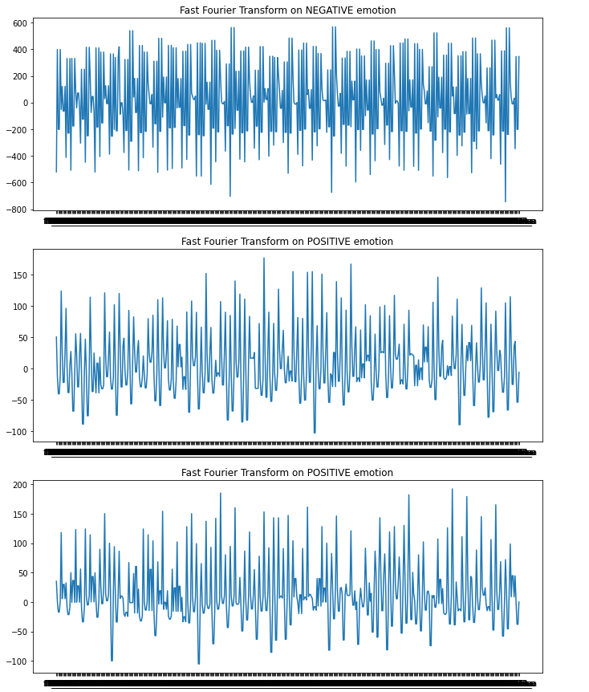

EEG Feeling Emotions
EEG Feeling Emotions – Classification with Logistic Regression.
Tell me, how are you feeling today? Oh wait, let me PREDICT it.
States your moods based on your brain electrical signals.

Slide 18
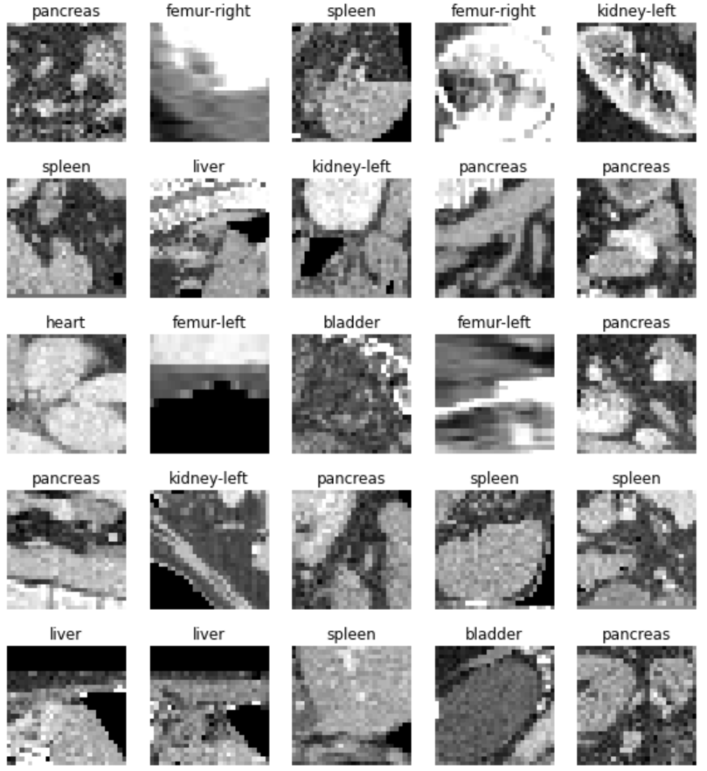
Medical Image Analysis
(with CNNs)
AI-based tools for Medical Image Analysis are allowing radiologists to become faster, better, and more accurate in diagnosis.
Use PyTorch to train a Convolutional Neural Network capable of classifying organs from Computed Tomography scans.

Slide 19
Workshop Plans for This Semester
Introductory & Welcome
👈 We are here!
Data Manipulation
Data Visualization
Basic Statistics
Data Science Bootcamp
Main Objective:
Familiarized with prevalent Machine Learning frameworks and Data Science tools
Grab basic techniques on fetching, processing and visualizing data
Experience on solving problems using machine learning algorithms
Understand how most AI models works under the hood
And more…
Classification
Regression
Clustering
Supervised &
Unsupervised Learning
Machine Learning
Fundamentals
Reading Week
Taste of AI
Artificial Neural Network
Convolutional Neural Network
Final Week

Slide 20
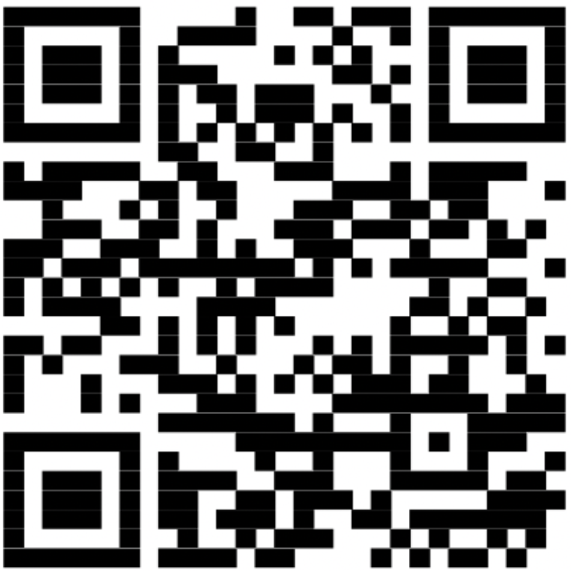
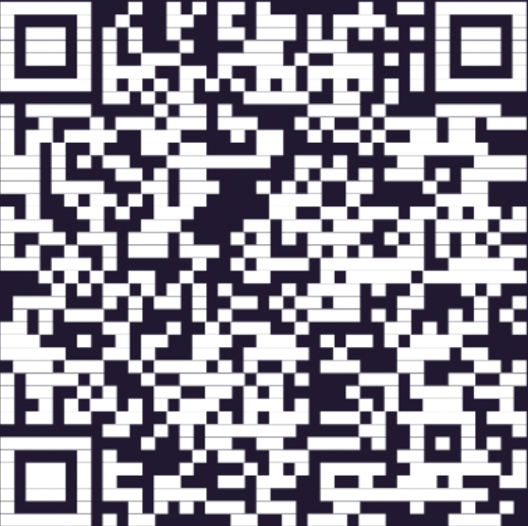
Open Committee Positions
First-year Representatives
Subject Ambassadors
Content Researchers

Slide 21

We’ve got two questions for you!
Demographic Enquiry

Slide 22
Any questions for us?

